Slide 1
Documenting Web API’s
Steven Suing, MCSD – Practice Manager
@stsuing
www.stevensuing.com

Slide 2
API History

Slide 3
SOAP vs HTTP+POX
SOAP
Doesn’t conform to HTTP Standards
Massive interoperability problems
WSDL describes custom service in a strongly types way
HTTP+POX
Based on HTTP Standards
Made to interoperate.
Documentation used to describe services in a loose way
Just do something that works.

Slide 4
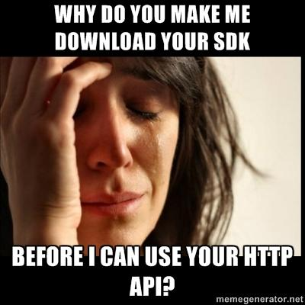
HTTP Api’s and SDK’s

Slide 5
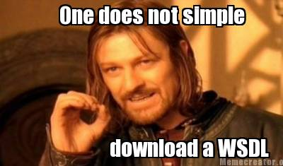
Creating a proxy for a Web API

Slide 6
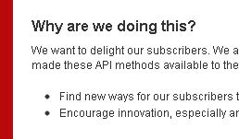
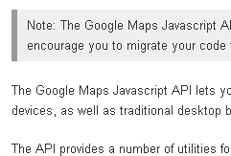
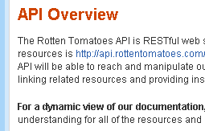
Elements of a good web API.
Provide an Overview of your service.

Slide 7
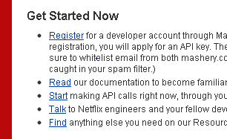
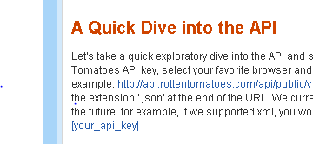
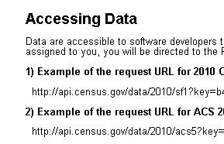
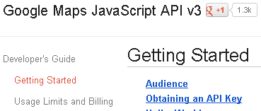
Elements of a good web API.
Getting Started
Netflix
RottenTomatos
Census
Google

Slide 8
Elements of a good web API
Getting Started components
Everything needed for Hello World
Security Consideration
High Level Information about working with API
Sample Hello World Code

Slide 9
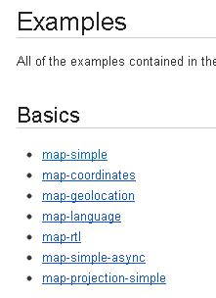
Elements of a good web API.
Samples and Examples
For example: http://api.rottentomatoes.com/api/public/v1.0.json?apikey=[your_api_key] Replace [your_api_key] with your own API key.
Census
1) Example of the request URL for 2010 Census SF1 data that has an assigned key inserted:
http://api.census.gov/data/2010/sf1?key=b48301d897146e8f8efd9bef3c6eb1fcb864cf&get=P0010001,NAME&for=state:*

Slide 10
Elements of a good web API.
Reference – the details of the API
Catalog of all service calls
For each service Call
Supported Media Types
Example Request and Response in each Media type
Business meaning for each service
Error codes and Meaning
Any possible State Transitions
Meta Data used to create Proxy - ??What does that Mean??

Slide 11
Demo
Variance

Slide 12
Examples
http://www.programmableweb.com/apilist
http://www.twilio.com/docs/index
Netflix - http://developer.netflix.com/
IMDB - http://www.omdbapi.com/
Meetup - http://www.meetup.com/meetup_api/docs/2/categories/
Census Data - http://www.census.gov/developers/
Google - http://code.google.com
Stack Exchange - http://api.stackoverflow.com/1.0/usage
Rotten Tomato's - http://developer.rottentomatoes.com/docs

